Slide 1


Slide 2
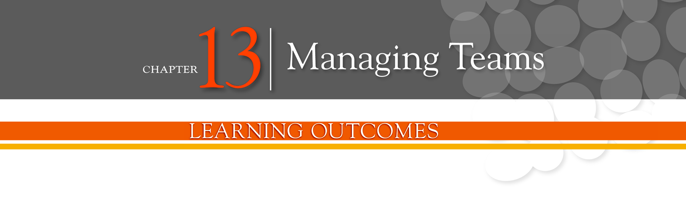
Define groups and the stages of group development
Describe the major components that determine group performance and satisfaction
Define teams and best practices influencing team performance
Discuss contemporary issues in managing teams

Slide 3
Groups
Group - two or more interacting and interdependent individuals who come together to achieve specific goals.
Formal groups
Work groups defined by the organization’s structure that have designated work assignments and tasks
Informal groups
Groups that are independently formed to meet the social needs of their members

Slide 4
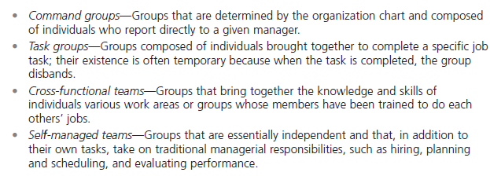
Exhibit 13-1: Examples of Formal Work Groups
Notes:
A group is defined as two or more interacting and interdependent individuals who come together to achieve specific goals. Formal groups are work groups that are defined by the organization’s structure and have designated work assignments and specific tasks directed at accomplishing organizational goals. Exhibit 13-1 provides some examples. Informal groups are social groups.

Slide 5
Group Development
Forming stage - the first stage of group development in which people join the group and then define the group’s purpose, structure, and leadership
Storming stage - the second stage of group development, characterized by intragroup conflict

Slide 6
Group Development (cont.)
Norming stage - the third stage of group development, characterized by close relationships and cohesiveness.
Performing stage - the fourth stage of group development when the group is fully functional and works on group task.
Adjourning - the final stage of group development for temporary groups during which group members are concerned with wrapping up activities rather than task performance.

Slide 7
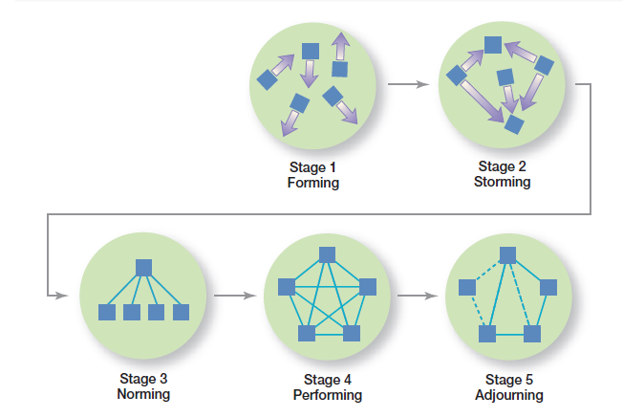
Exhibit 13-2: Stages of Group Development
Notes:
Research shows that groups develop through five stages. As shown in Exhibit 13-2, these five stages are forming, storming, norming, performing, and adjourning

Slide 8
Group Structure
Role - behavior patterns expected of someone occupying a given position in a social unit.
Norms - standards or expectations that are accepted and shared by a group’s members.
Groupthink - when a group exerts extensive pressure on an individual to align his or her opinion with that of others.

Slide 9
Group Structure (cont.)
Status - a prestige grading, position, or rank within a group.
Social loafing - the tendency for individuals to expend less effort when working collectively than when working individually.
Group cohesiveness - the degree to which group members are attracted to one another and share the group’s goals.

Slide 10
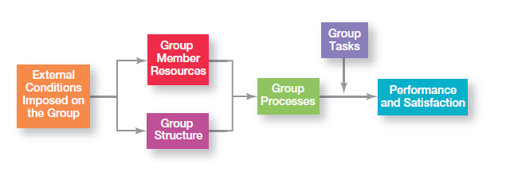
Exhibit 13-3: Group Performance/Satisfaction Model
Notes:
Why are some groups more successful than others? Why do some groups achieve high levels of performance and high levels of member satisfaction and others do not? The answers are complex, but include variables such as the abilities of the group’s members, the size of the group, the level of conflict, and the internal pressures on members to conform to the group’s norms. Exhibit 13-3 presents the major factors that determine group performance and satisfaction.

Slide 11
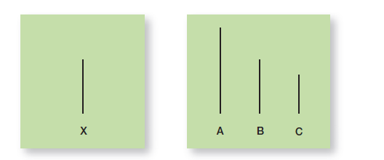
Exhibit 13-4: Examples of Asch’s Cards
Notes:
Asch demonstrated the impact that conformity has on an individual’s judgment and attitudes. In these experiments, groups of seven or eight people were asked to compare two cards held up by the experimenter. One card had three lines of different lengths and the other had one line which was equal in length to one of the three lines on the other card (see Exhibit 13-4).

Slide 12
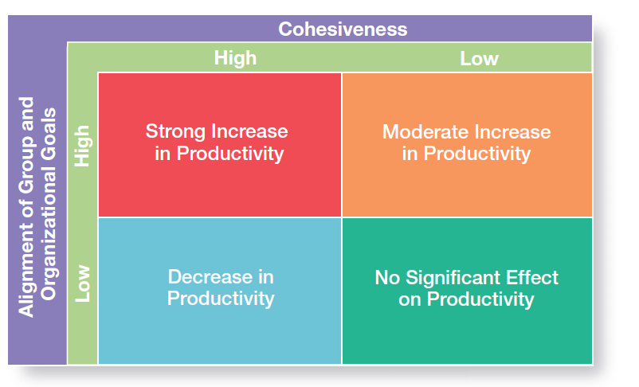
Exhibit 13-5: Group Cohesiveness and Productivity
Notes:
Research has generally shown that highly cohesive groups are more effective than are less cohesive ones. However, the relationship between cohesiveness and effectiveness is complex. A key moderating variable is the degree to which the group’s attitude aligns with its goals or with the goals of the organization. (See Exhibit 13-5.)

Slide 13
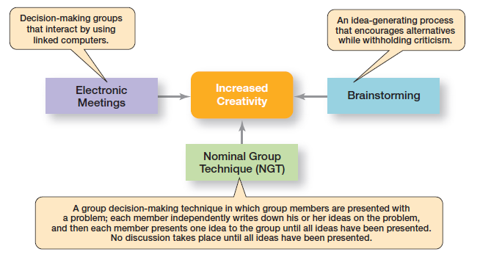
Exhibit 13-6: Creative Group Decision Making
Notes:
What techniques can managers use to help groups make more creative decisions? Exhibit 13-6 describes three possibilities.

Slide 14
Conflict Management
Conflict - perceived incompatible differences that result in interference or opposition.
Traditional view of conflict - the view that all conflict is bad and must be avoided.
Human relations view of conflict - the view that conflict is a natural and inevitable outcome in any group

Slide 15
Conflict Management (cont.)
Inter-actionist view of conflict - the view that some conflict is necessary for a group to perform effectively.
Functional conflicts - conflicts that support a group’s goals and improve its performance.
Dysfunctional conflicts - conflicts that prevent a group from achieving its goals.

Slide 16
Conflict Management (cont.)
Task conflict - conflicts over content and goals of the work.
Relationship conflict - conflict based on interpersonal relationships.
Process conflict - conflict over how work gets done.

Slide 17
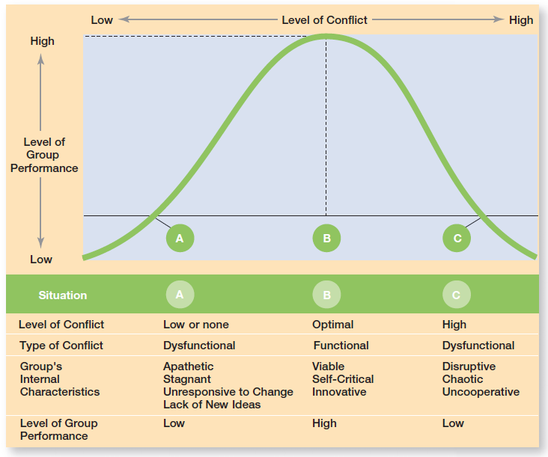
Exhibit 13-7: Conflict and Group Performance
Notes:
Some conflicts— functional conflicts—are constructive and support the goals of the work group and improve its performance. Other conflicts—dysfunctional conflicts—are destructive and prevent a group from achieving its goals. Exhibit 13-7 illustrates the challenge facing managers.

Slide 18
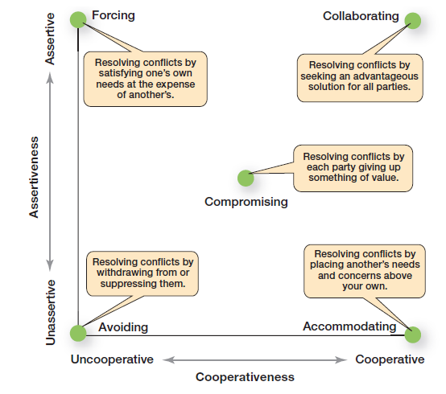
Exhibit 13-8: Conflict-Management Techniques
Notes:
When group conflict levels are too high, managers can select from five conflict management options: avoidance, accommodation, forcing, compromise, and collaboration. (See Exhibit 13-8 for a description of these techniques.) Keep in mind that no one option is ideal for every situation. Which approach to use depends upon the circumstances at hand.

Slide 19
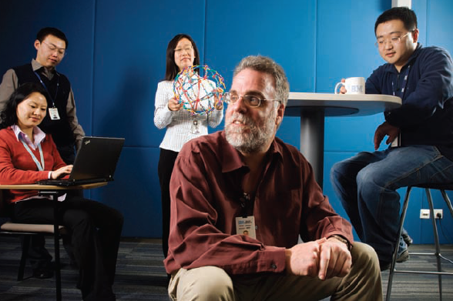
What Is a Work Team?
Work teams - groups whose members work intensely on a specific, common goal using their positive synergy, individual and mutual accountability, and complementary skills.

Slide 20
Types of Work Teams
Problem-solving team - a team from the same department or functional area that’s involved in efforts to improve work activities or to solve specific problems.
Self-managed work team - a type of work team that operates without a manager and is responsible for a complete work process or segment.

Slide 21
Types of Work Teams (cont.)
Cross-functional team - a work team composed of individuals from various functional specialties.
Virtual team - a type of work team that uses technology to link physically dispersed members in order to achieve a common goal.

Slide 22
Advantages of Using Teams
Teams outperform individuals.
Teams provide a way to better use employee talents.
Teams are more flexible and responsive.
Teams can be quickly assembled, deployed, refocused, and disbanded.

Slide 23
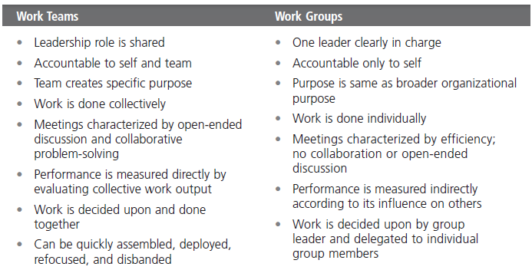
Exhibit 13-9: Groups Versus Teams
Notes:
Most of you are probably familiar with teams especially if you’ve watched or participated in organized sports events. Work teams differ from work groups and have their own unique traits (see Exhibit 13-9).

Slide 24
Characteristics of Effective Teams
Have a clear understanding of their goals
Have competent members with relevant technical and interpersonal skills
Exhibit high mutual trust in the character and integrity of their members
Are unified in their commitment to team goals
Have good communication systems
Possess effective negotiating skills
Have appropriate leadership
Have both internally and externally supportive environments

Slide 25
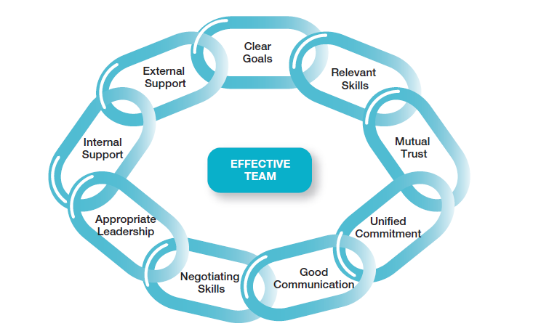
Exhibit 13-10: Characteristics of Effective Teams
Notes:
Research on teams provides insights into the characteristics typically associated with effective teams. These characteristics are listed in Exhibit 13-10.

Slide 26
Understanding Social Networks
Social Network
The patterns of informal connections among individuals within groups.
The Importance of Social Networks
Relationships can help or hinder team effectiveness.
Relationships improve team goal attainment and increase member commitment to the team.

Slide 27
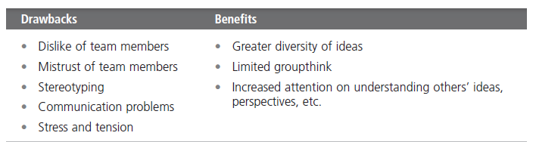
Exhibit 13-11: Global Teams
Notes:
Two characteristics of today’s organizations are obvious: They’re global and work is increasingly done by teams. These two aspects mean that any manager is likely to have to manage a global team. What do we know about managing global teams? We know there are both drawbacks and benefits in using global teams (see Exhibit 13-11).

Slide 28
Terms to Know
group
forming stage
storming stage
norming stage
performing stage
adjourning stage
role
norms
groupthink
status
social loafing
group cohesiveness
conflict
traditional view of conflict
human relations view of conflict
interactionist view of conflict
functional conflicts
dysfunctional conflicts
task conflict
relationship conflict
process conflict
work teams
problem-solving team
self-managed work team
cross-functional team
virtual team
social network structure

